Slide 1
Software Development Anti-Patterns
Dustin Kieler
Joel Keyser

Slide 2
What is an Anti-Pattern?
An anti-pattern is a development pattern that looks like a good idea, but backfires when applied
Very common in all levels of programming experience
Haste is a large cause – pushes for speedy development often leads to poor development
Often solves the problem, but in a way that
The maintainability decreases
The solution is less efficient
The solution took way more time than it should have

Slide 3

Reinventing the Wheel

Slide 4
Reinventing the Wheel
Rewriting already existing code.
Identifiers
Writing utility functions that exist in a common library already
Writing code that exists somewhere else in the project
Causes
Developers want to write it themselves (Not Invented Here syndrome)
Developers may not take the time to look for existing code
Organization refuses to purchase or use another organization’s code
Solutions
Include a library dependency if it’s related and useful to your task
In general, only write your own code if you have to

Slide 5
The Blob
One class swallows up most of the processing work and other classes remain as merely data objects, destroying testability and OO design, and increasing expense.
Identifiers
“You know, this class is truly the heart of our application.”
“Just throw it in *insert gigantic class here*; it’ll be the fastest, and we can refactor it later.”
Causes
Lack of defined architecture
Haste
Often found in Agile, where the class grows to accommodate requested features rather than being broken down into new modules
Solutions
Separate out responsibilities
Rethink your architecture

Slide 6
The Blob: Example
Reqster.cs

Slide 7
Lava Flow
Dead code.
Identifiers
“Joel wrote that code last sprint, and I’m not entirely sure what it does, but he might need it later… so let’s just leave it there for now.”
Causes
Laziness
Lack of documentation
Heroic programming
Solutions
Rethink your architecture
Enforce the architecture using configuration management

Slide 8
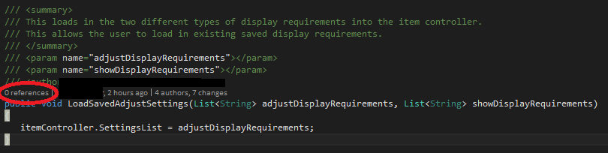
Lava Flow: Example

Slide 9
Walking through a Minefield
The user has a feeling that the program could crash at any time.
Identifiers
“What are the chances it works this time?”
“Should we just restart Visual Studio?”
Causes
Lack of testing
Poorly defined requirements
Solutions
Invest more time in testing
Automated testing

Slide 10
Walking through a Minefield: Example
“We need to think of a demo plan that avoids as many bugs as possible.”

Slide 11
Cut-And-Paste Programming
Code that is taken from another source and slightly modified for a similar purpose, without a full understanding of how the code works.
Identifiers
“This code will probably work here. Let’s find out.” “Sweet it works let’s use it.”
“Hey Kieler, do you know how to do this?” “Nope. To StackOverflow!”
Causes
Programmers are unfamiliar with new technology or tools
Emphasis on short-term payoff more than long-term investment
Solutions
Document the taken code and try to make it reusable
Emphasize reusability

Slide 12
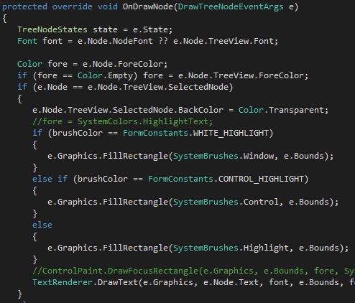
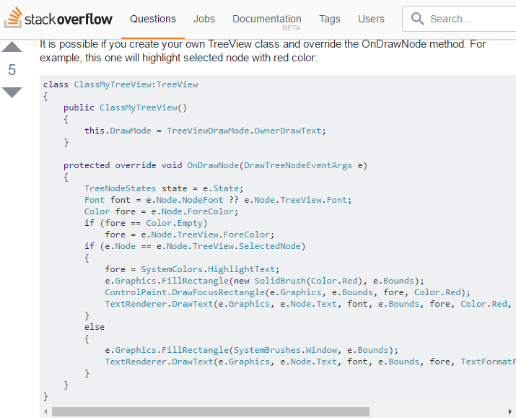
Cut-And-Paste Programming: Example

Slide 13
Coding by Exception
Code that is written because an exception occurred.
Identifiers
“Just throw a try-catch around it. ☺”
“This is the 10th exception I’ve made a fix for in this block of code. ☹”
Causes
Lack of identifying possible problems before running code
Poor requirements
Solutions
Brainstorm potential issues before writing code

Slide 14
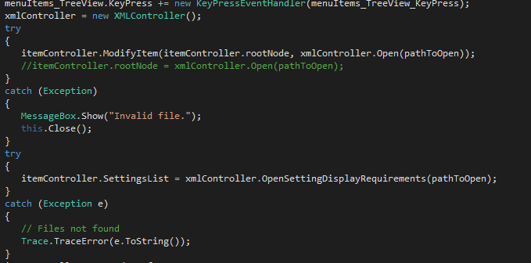
Coding by Exception: Example

Slide 15
Error Hiding
Not displaying enough information about an error to the user.
Identifiers
“I like how this message says nothing about the actual error at all!”
try {…} catch (Exception) {}
Causes
Lazy error handling
Solutions
Take time to provide a proper error message
Log the stack trace for developer use

Slide 16
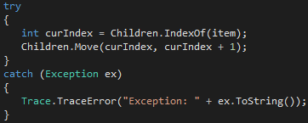
Error Hiding: Example

Slide 17
Repeating Yourself
Using the same code in multiple places.
Identifiers
“I feel like I’ve seen this before…”
Furiously tapping Ctrl + C & Ctrl + V
Causes
Lack of knowledge of a better solution
Haste
Solutions
Emphasize making code reusable

Slide 18
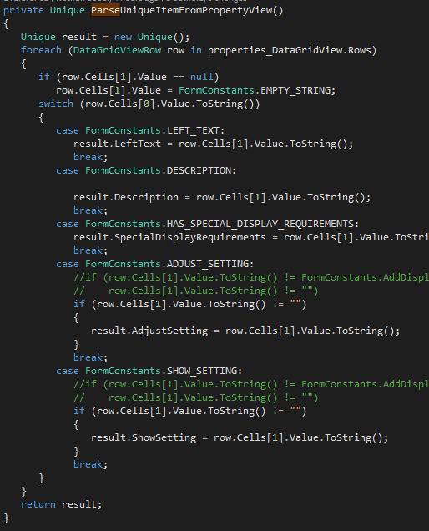
Repeating Yourself: Example

Slide 19
Repeating Yourself
Using the same code in multiple places.
Identifiers
“I feel like I’ve seen this before…”
Furiously tapping Ctrl + C & Ctrl + V
Causes
Lack of knowledge of a better solution
Haste
Solutions
Emphasize making code reusable

Slide 20

Premature Optimization
Working towards an optimal algorithm instead of an acceptable algorithm, where finding the optimal algorithm will take a significantly longer amount of time. "We should forget about small efficiencies, say about 97% of the time: premature optimization is the root of all evil. Yet we should not pass up our opportunities in that critical 3%“
Identifiers
“I think we could make this faster…”
“…maybe not.”
“I can’t read the code I just wrote, but hey, it saved us 25ms!”
Causes
Confusing priorities
Code performance pride
you’re often taught the “fastest” way to do everything so you always try to find the fastest code
Solutions
Worry about performance when it becomes an issue to the user
Prioritize readability over miniscule efficiency improvements
Get the code working.
Verify the code is correct.
Make it fast.

Slide 21
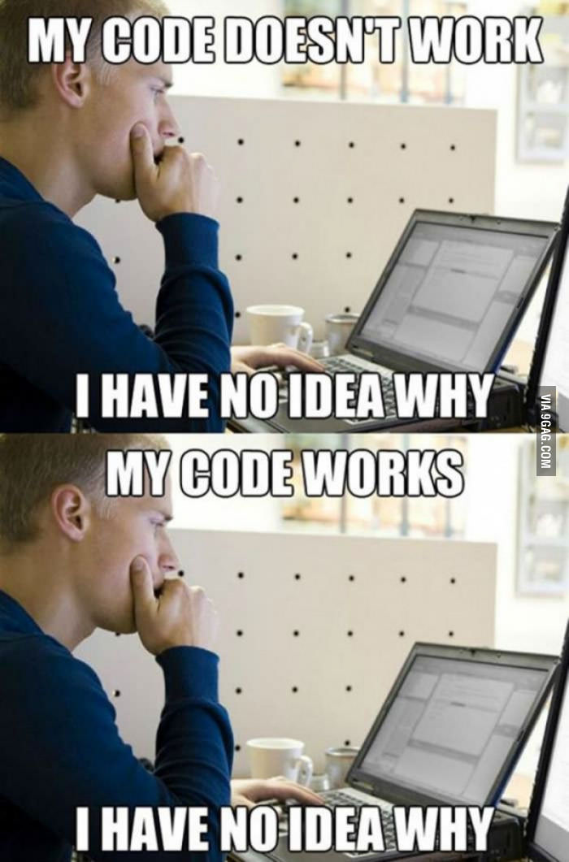
Programming by Permutation
Iteratively making small changes until it [magically] works.
Identifiers
“What if I do this? Nope. Okay, what if I do this?
Not sure why that works, but it does.”
Causes
Lack of planning
Inexperience with features of a language
Haste
Solutions
Take time to design
Try to understand what’s going wrong instead of
trying random solutions

Slide 22
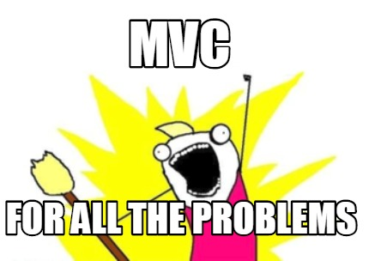
The Golden Hammer
Using a data structure/design pattern/tool in a situation solely because you have the most knowledge of it, rather than using a more appropriate one.
Identifiers
Causes
Lack of knowledge of a better solution
Lack of effort to find a better solution
Solutions
Explore new technologies
Use a tool appropriate for the specific job

Slide 23
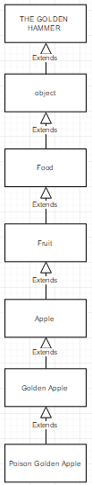
The Yo-Yo Problem
Inheritance that is so deep that the code is difficult to follow.
Identifiers
Having to keep flipping between many different classes in order
to follow the flow of the program
Causes
Multiple inheritance (if the language supports it)
Over-simplifying objects where not much reuse is incurred
Solutions
Sometimes composition is better than inheritance
Don’t use unnecessary inheritance

Slide 24
Improbability Factor
Avoiding fixing a catastrophic issue because it is unlikely to occur.
Identifiers
“I had this weird bug the other day, but it hasn’t happened since, so let’s just hope it doesn’t happen during the demo. ☺”
Causes
The fix has not been properly prioritized
Haste
Solutions
Prioritize fixing crashes in the system
Murphy’s Law – Anything that can go wrong, will go wrong.

Slide 25
Sources
"Anti Pattern." Wiki.c2.com. N.p., 21 Nov. 2012. Web. 10 Apr. 2017. <http://wiki.c2.com/?AntiPattern>.
Richards, Mark. "Software Development Anti-Patterns." (2015): n. pag. Software Design and Development Conference 2015. Web. 10 Apr. 2017.
Shvets, Alexander, Gerhard Frey, and Marina Pavlova. "Design Patterns and Refactoring."SourceMaking. N.p., 2006. Web. 10 Apr. 2017.

